Slide 1





AUTO/TAXI STAND MANAGEMENT SYSTEM
Team Members:
D DILLI SUDHA Guide: UMA MAHESHWARI R
C DEEPTI
P HARIKA
B GOPI CHANDANA

Slide 2
OUTLINE
Abstract
Problem Statement
Aims, Objective & Proposed Solution
System Design/Architecture
System Development Approach (Technology Used)
Deployment
Conclusion
Future Scope
References
Notes:
These are the list of chapters that we are going to cover in these foundation codes. Those are chapter one what are AI and ML? chapter 2 applied Python programming in AI, and chapter 3 is exploratory data analysis for ML.

Slide 3
Abstract
The Auto Taxi Stand Management System (ATSMS) is a comprehensive software solution designed to streamline and optimize the operations of auto taxi stands. It incorporates various features including automated booking, real-time tracking of vehicles, efficient allocation of taxis, and digital payment options, thereby enhancing the overall efficiency and convenience for both passengers and drivers. The system utilizes advanced technologies such as GPS tracking and data analytics to ensure prompt service delivery and effective management of resources. By facilitating seamless communication between passengers and drivers, ATSMS aims to minimize waiting times, reduce congestion at stands, and improve the overall user experience in urban transportation networks.

Slide 4
Problem Statement
The problem statement for the Auto Taxi Stand Management System (ATSMS) is the lack of efficient coordination and management of auto taxi stands, leading to long waiting times for passengers, inefficient allocation of vehicles, and congestion at stands. Existing systems often rely on manual processes, resulting in inconsistencies, delays, and inconvenience for both passengers and drivers. ATSMS aims to address these challenges by introducing an automated and integrated solution for the seamless management and operation of auto taxi stands.

Slide 5
Aim and Objective
Aim:
The aim of the project is to develop a robust Auto Taxi Stand Management System (ATSMS) to enhance the efficiency and convenience of urban transportation networks.
Objectives:
Create a User-Friendly Platform
Support and Promote Sustainable Practices
Encourage Driver Community Engagement
Educate and Raise Awareness

Slide 6
Proposed Solution
The proposed Solution of Auto Taxi Stand Management System (ATSMS) integrates booking, tracking, and payment functionalities to optimize auto taxi operations. It offers passengers an intuitive interface, reducing wait times and enhancing satisfaction. Additionally, it promotes eco-friendly driving practices, fosters driver community engagement, and educates users through integrated initiatives. Overall, ATSMS aims to enhance efficiency, satisfaction, and sustainability in urban transportation networks.

Slide 7
System Architecture
Customer Module:
Customer
Booking Module
Payment Module
Tracking
Feedback and Rating
Notification module

Slide 8
Driver Module:
Driver
Booking and Dispatch
Real time tracking
Driver Management Module
Payment and Fare management
Feedback and Performance

Slide 9
Deployment Steps
1. Preparation and Setup:
-Verify system requirements
-Set up development and production environments
2. Installation and Configuration:
-Install Software's to run our project
-Configure database settings
3. Testing and Quality Assurance:
-Conduct system testing
-Implement quality assurance measures
4. Data Migration and Integration:
-Migrate existing data
-Integrate third-party services
5. Deployment and Go-Live:
-Finalize deployment plan
-Monitor system performance

Slide 10
Technology Used
Operating System: Windows 11
Front-End: HTML, CSS, JavaScript
Back-End: PHP
Database: MySQL
Server: Xampp

Slide 11
Conclusion
In conclusion, the development and implementation of the auto stand management project represent a significant step towards enhancing the efficiency, accessibility, and sustainability of urban transportation networks. By leveraging modern technologies such as real-time tracking, digital booking, and community engagement features, the system has the potential to revolutionize the way auto taxi services are operated and utilized. Through seamless coordination between passengers, drivers, and administrators, coupled with a focus on promoting sustainable practices and user education, the project aims to not only improve the overall user experience but also contribute to reducing congestion, optimizing resource allocation, and fostering a more environmentally friendly approach to urban mobility.

Slide 12
Future Scope
The future scope of the Auto Stand Management project holds promising potential for several advancements:
Diversification of Services: Expanding beyond auto taxi management, the platform could incorporate other transportation modes such as bike-sharing or electric scooters, catering to a broader range of commuters and promoting multi-modal transportation solutions.
Integration of Smart Infrastructure: Incorporating IoT (Internet of Things) sensors and smart city infrastructure could enable real-time monitoring of auto stand utilization, traffic patterns, and environmental conditions.
Collaboration with Public Transit Authorities: Partnering with public transit agencies to integrate auto stands with existing bus and train routes could provide passengers with seamless, door-to-door transportation options.
Community Engagement and Feedback Mechanisms: Developing features to facilitate communication and feedback between passengers, drivers, and local communities could foster a sense of ownership and collaboration in the management of auto stands.

Slide 13
References
Smith, J., & Johnson, A. (2020). "Integrating Auto Taxi Stands with Public Transit: A Case Study of Urban Mobility Solutions." Transportation Research Record, 2678(1), 45-52.
Chen, L., & Wang, Q. (2019). "Optimizing Auto Stand Locations using Machine Learning Algorithms." Journal of Urban Transportation, 46(3), 321-335.
Green, M., & Jones, R. (2021). "Smart City Solutions for Auto Stand Management: Leveraging IoT and Big Data Analytics." Proceedings of the International Conference on Smart Cities, 112-125.
Sustainable Transport International. (2022). "Best Practices for Sustainable Auto Stand Management: Lessons from Global Case Studies." Retrieved from https://www.sustainabletransport.org/publications/best-practices-auto-stand-management/
Urban Mobility Institute. (2023). "Community Engagement Strategies for Auto Stand Management: A Guide for Local Authorities." Retrieved from https://www.urbanmobilityinstitute.org/resources/auto-stand-engagement-guide/
Notes:
Reference
These are the references for this session.
13

Slide 14
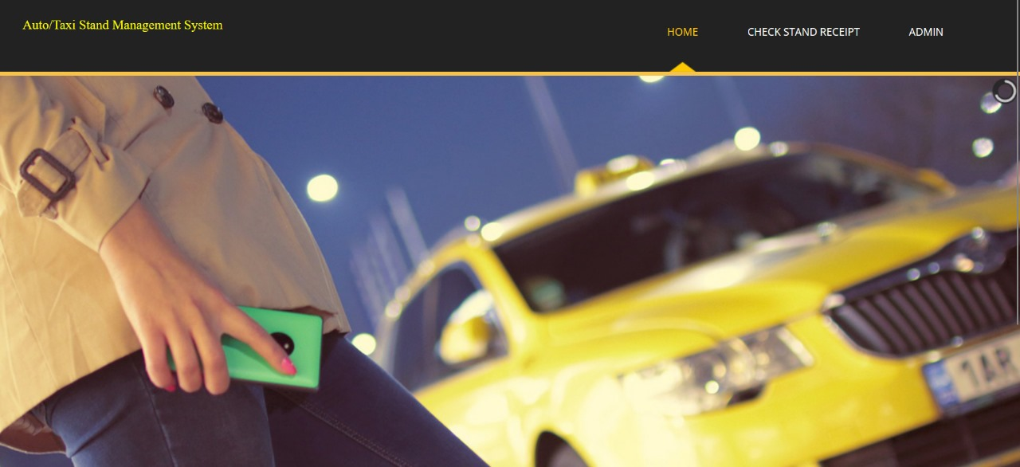
Frontend part

Slide 15
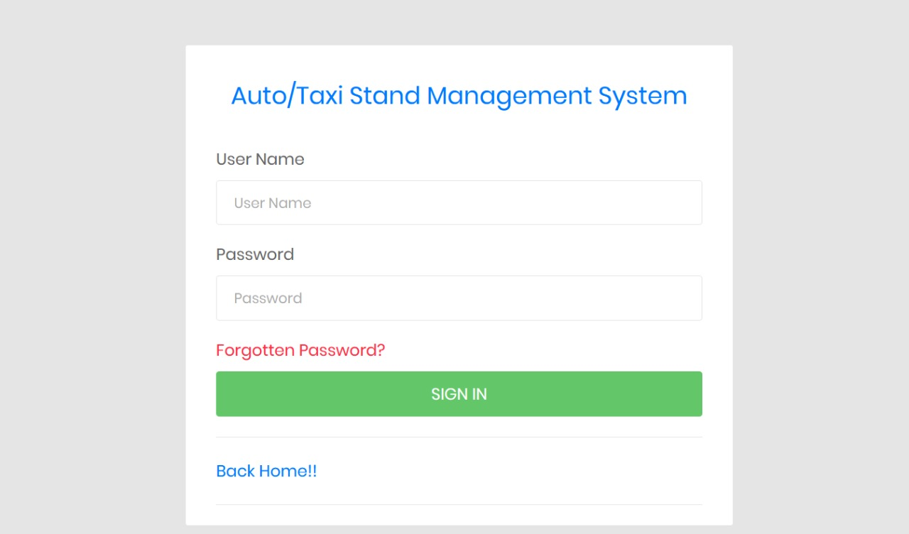
Frontend part
Admin Login Page:

Slide 16
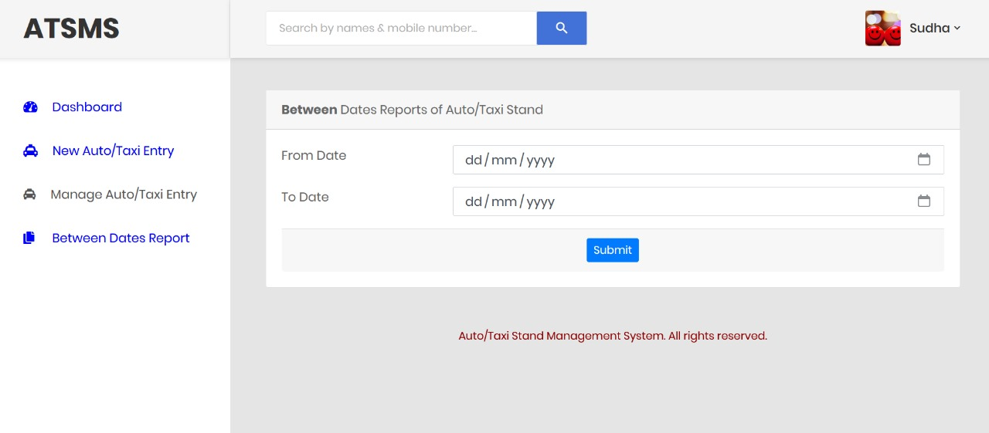
Frontend part
Home Page:

Slide 17
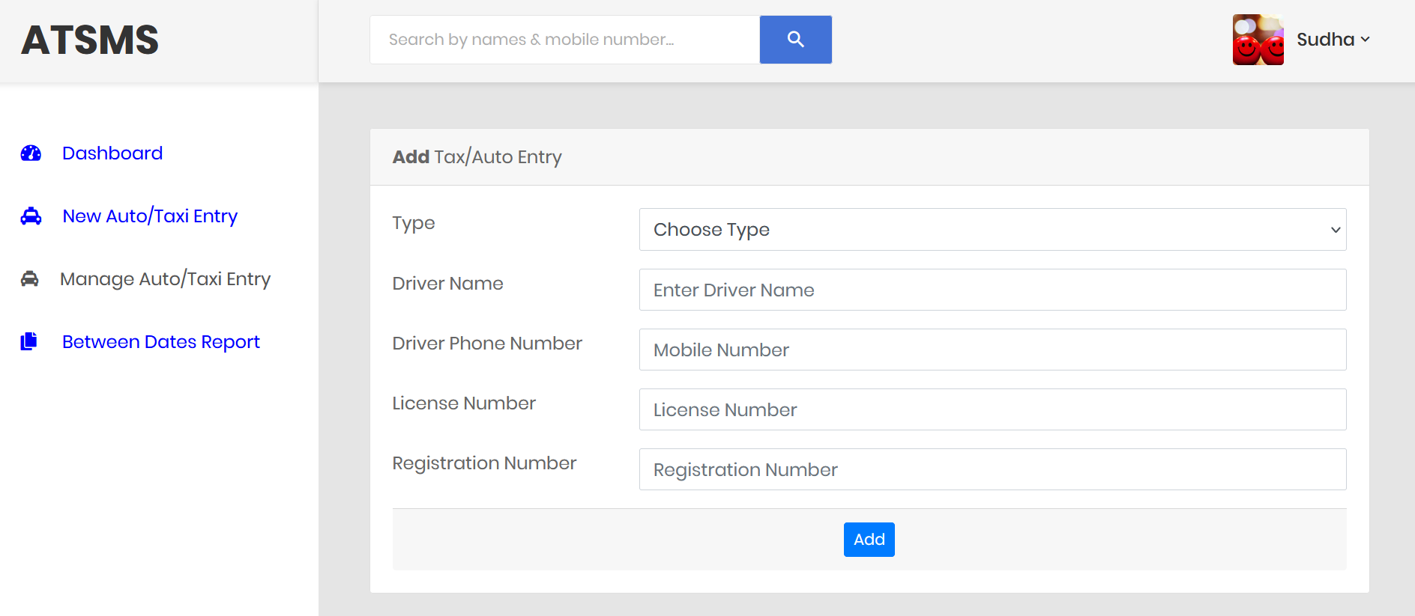
Frontend part

Slide 18
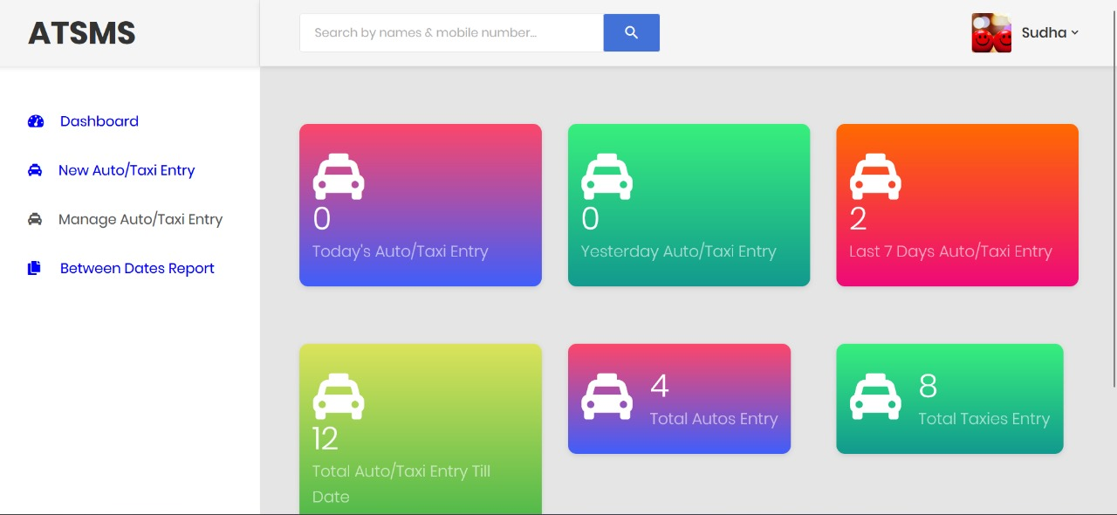
Frontend part

Slide 19
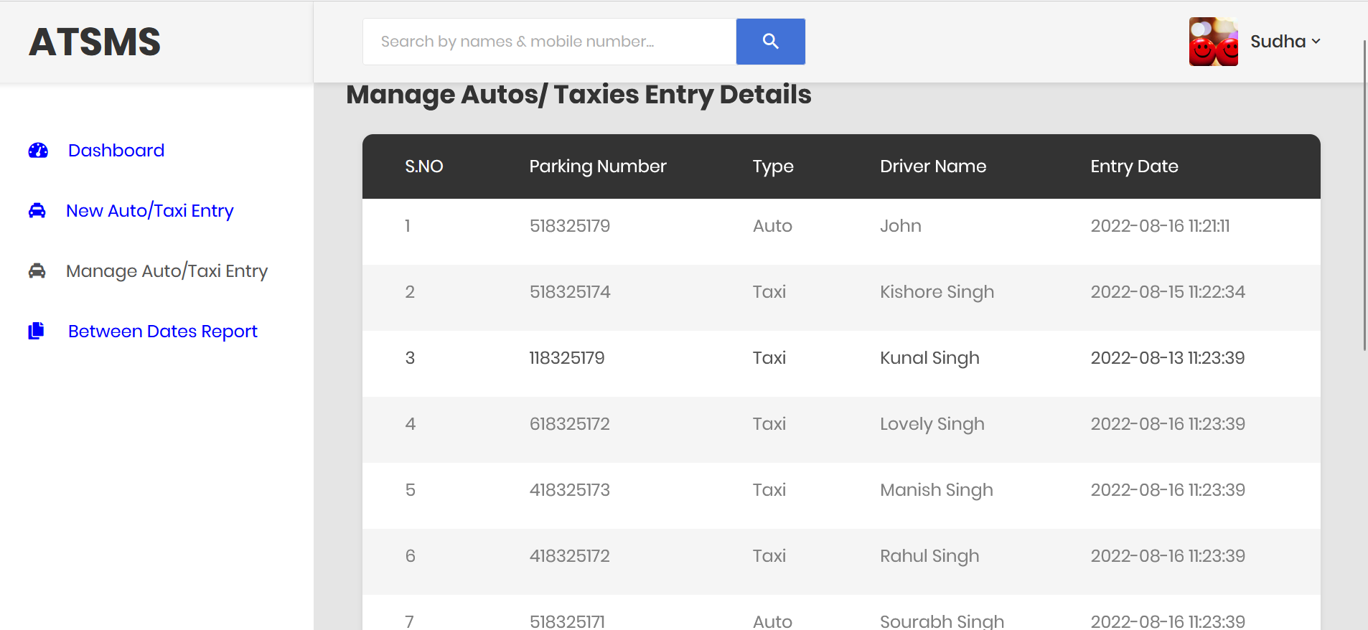
Frontend part

Slide 20
Thank you!
Notes:
thank you very much for joining this PPT, keep learning.
20

